Slide 1
PACK_CTN BOOK GUIDE
Employee name: 阮文強
Department: IT-SFIS VN
Prepare date: 01-01-2022

Slide 2
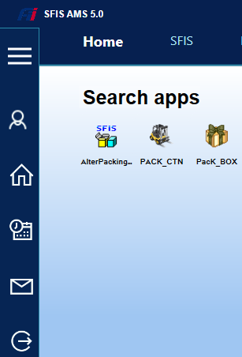
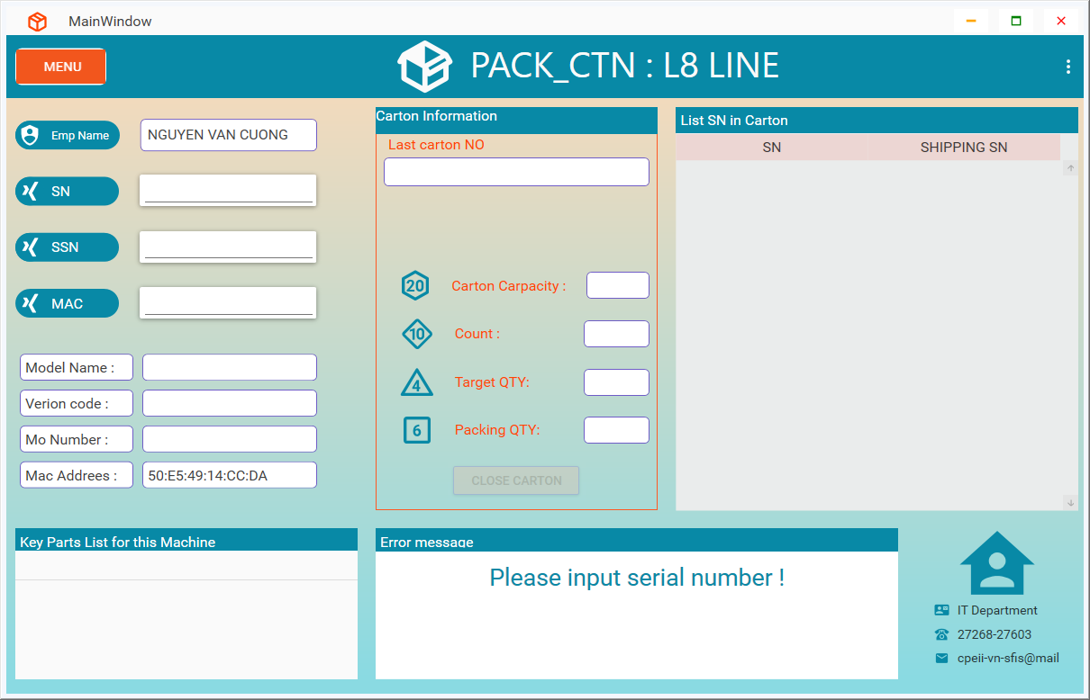
PACK_CTN BOOK GUIDE
Login program
Login to SFIS_AMS then double click on PACK_CTN program.
Login OK

Slide 3
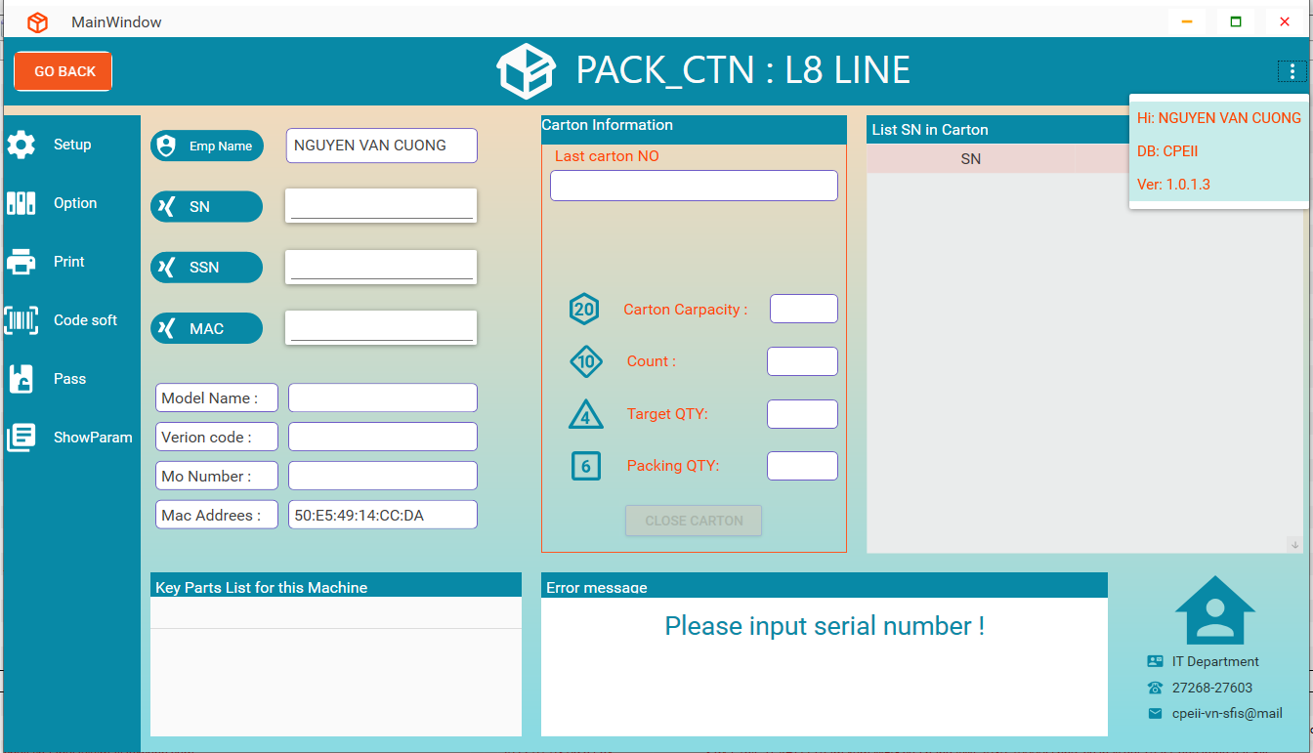
PACK_CTN BOOK GUIDE
Main interface item
Click this button for show information of program
Click button MENU for show menu
Main menu

Slide 4
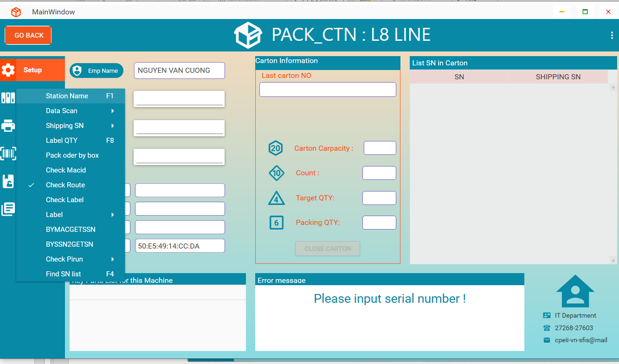
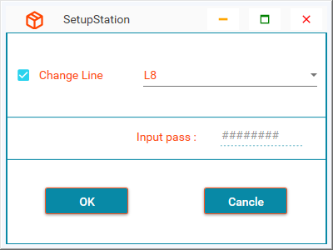
PACK_CTN BOOK GUIDE
Menu SETUP
1. Setup Station Name
Click item Station Name for show form setup station
Form setup station
2
3
Click: Change Line
Choose line name
3
1
Click button OK for save change
Input pass : AMBITCTN

Slide 5
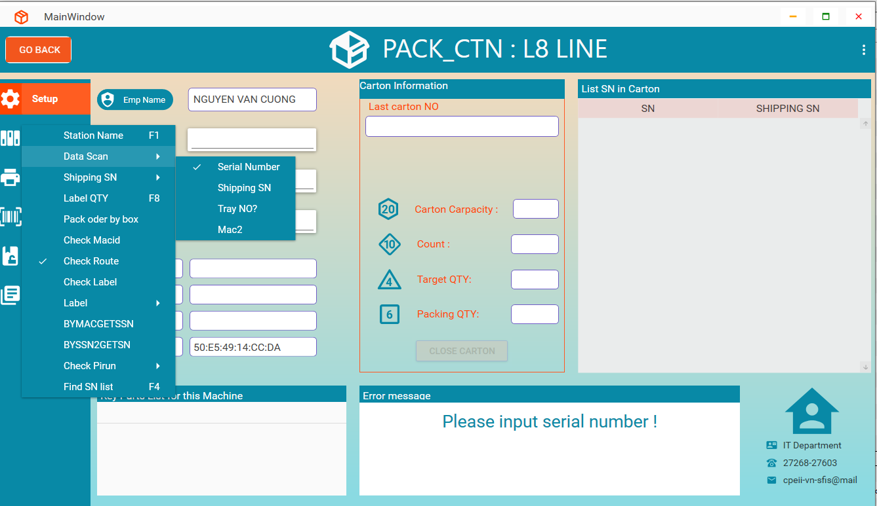
PACK_CTN BOOK GUIDE
Menu SETUP
2. Setup data scan
Click item
Data Scan
Click choose the item that matches with data input
3
Choose line name

Slide 6
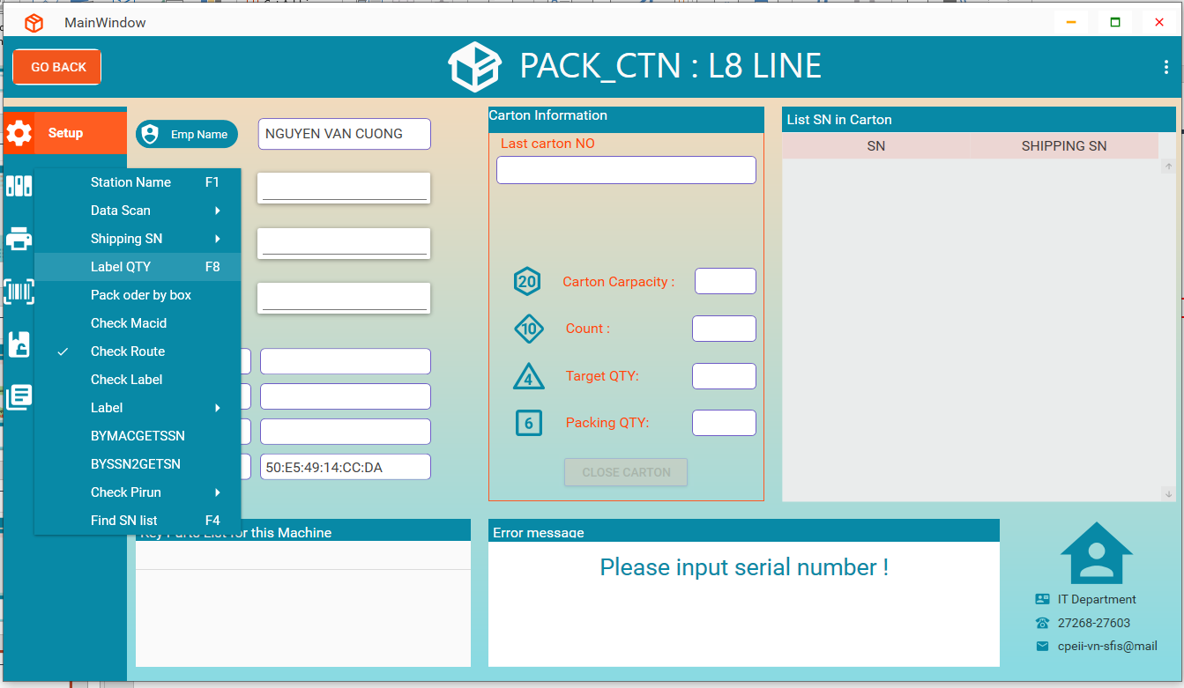
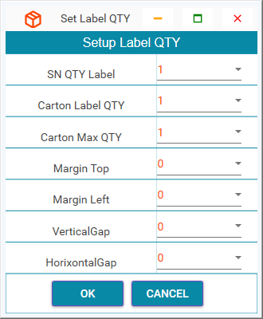
PACK_CTN BOOK GUIDE
Menu SETUP
3. Setup label QTY
Click item Label QTY for show form setup label QTY
Form setup label QTY

Slide 7
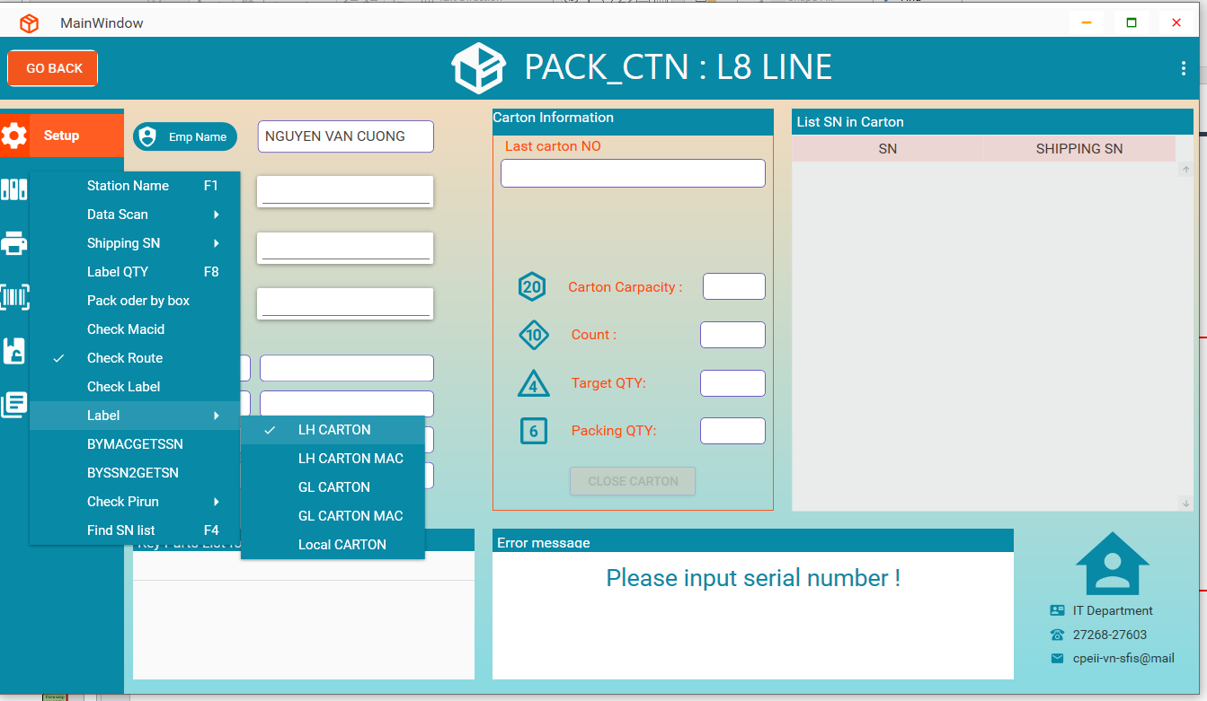
PACK_CTN BOOK GUIDE
Menu SETUP
4. Setup label file
+) LH CARTON
10.224.81.30/ftp/Packing2_CS6-CTN
Click item Label
Click choose the item that matches with label file

Slide 8
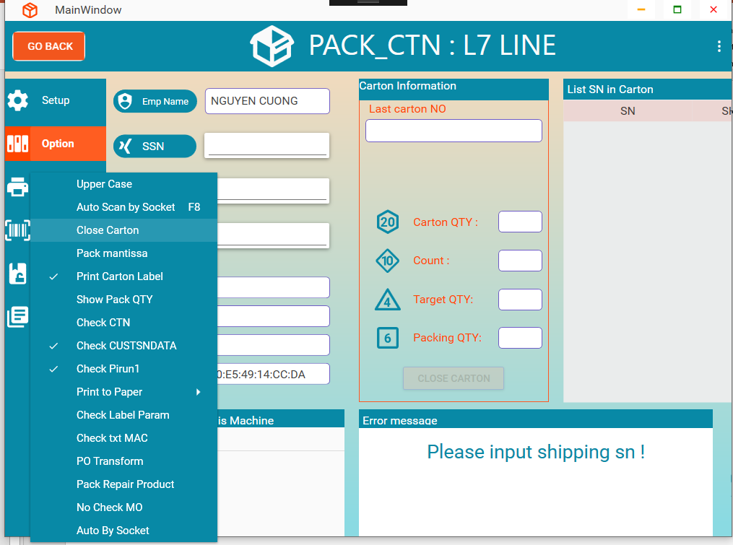
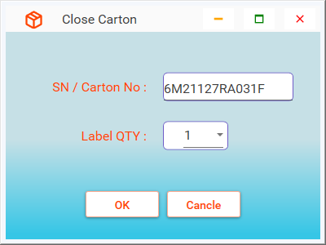
PACK_CTN BOOK GUIDE
Menu OPTION
1. Funtion Close Carton
=> Scan SN in carton no need close

Slide 9
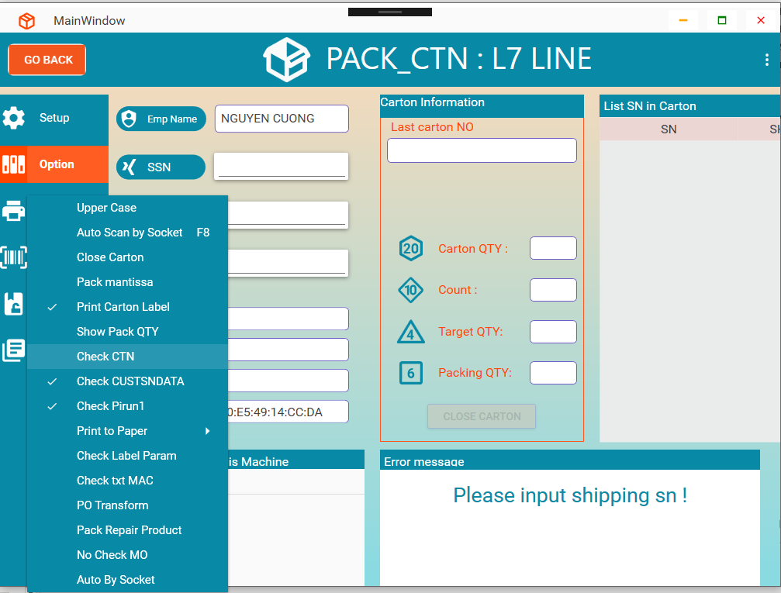
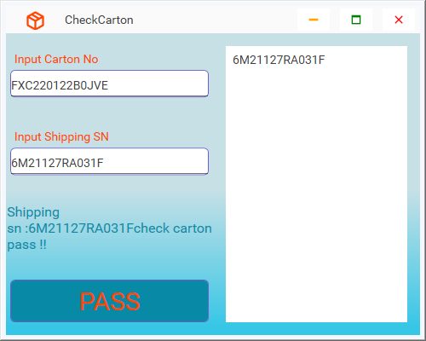
PACK_CTN BOOK GUIDE
Menu OPTION
2. Funtion Check CTN
=> For OBA check sn in carton

Slide 10
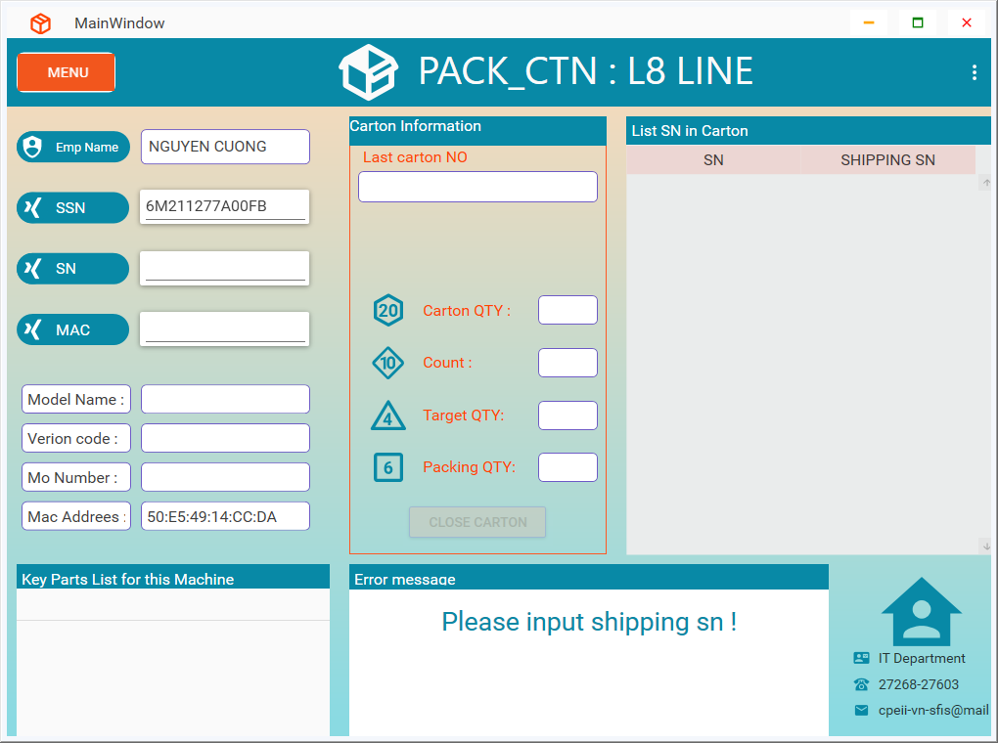
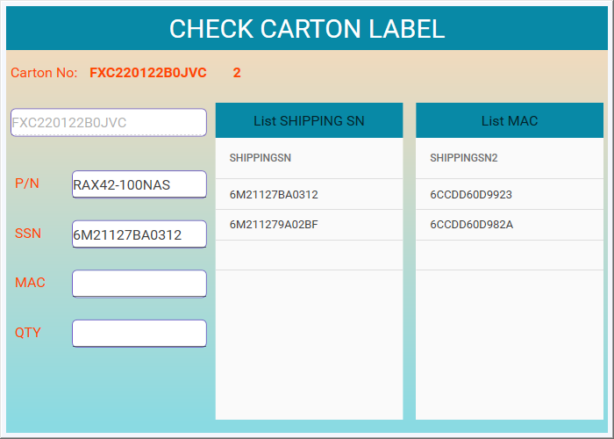
PACK_CTN BOOK GUIDE
Menu OPTION
3. Funtion Check carton label
Form show when model have model_type “177”
1 : Scan mcarton no
2 : Scan P/N
1
3 : Scan SSN
2
3
4 : Scan MAC
4
5 : scan QTY After scan ssn and mac finish
5

Slide 11
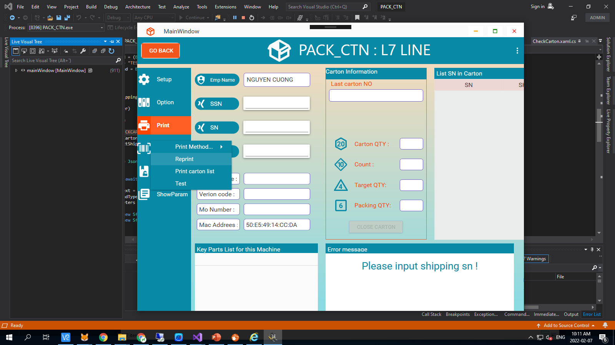
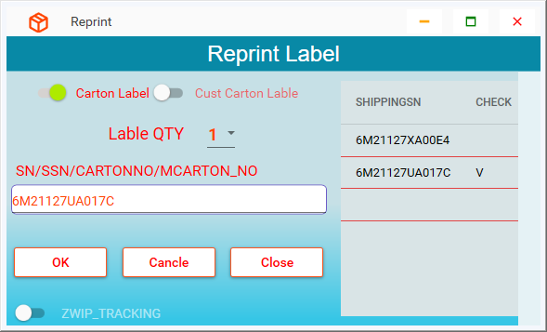
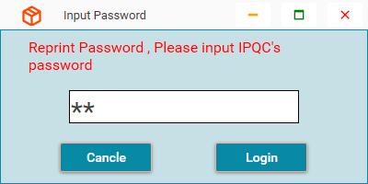
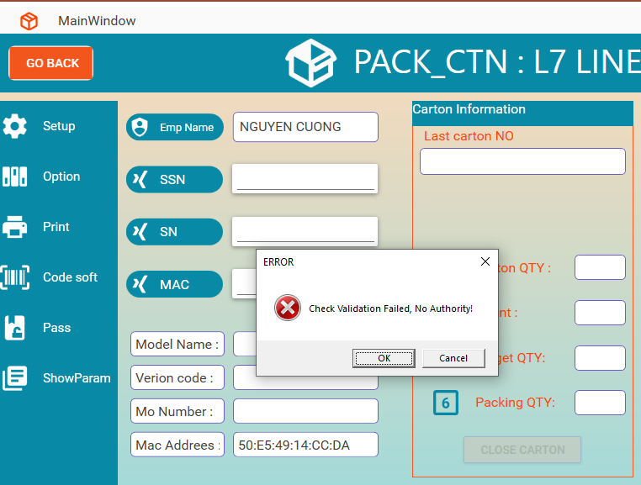
PACK_CTN BOOK GUIDE
Menu Print
1. Funtion Reprint
After Login ok show form reprint label
OK
NG

Slide 12
PACK_CTN BOOK GUIDE
THANKS FOR WATCHING

